Slide 1

Organizational Behaviour - BM505H
School of Business, IITG
Dr. Sumant Kumar Bishwas

Slide 2
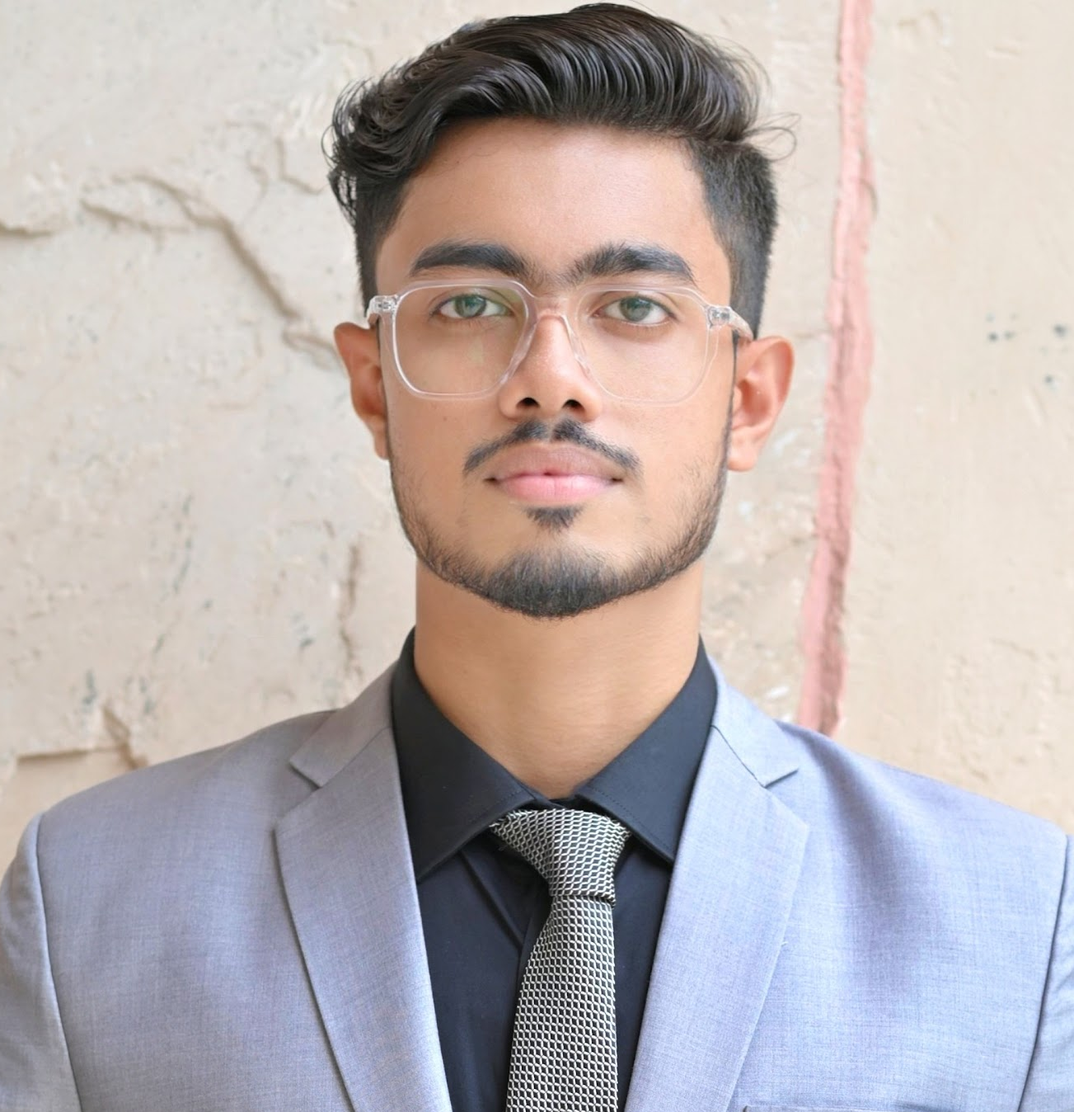
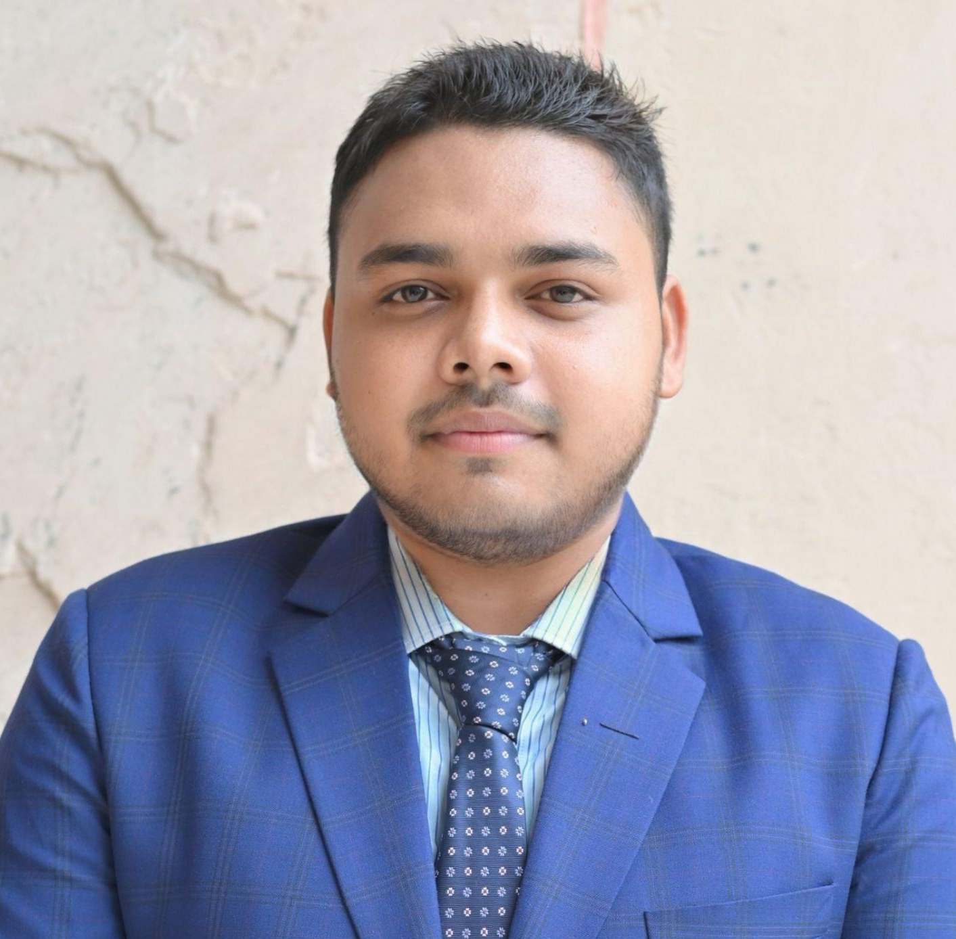
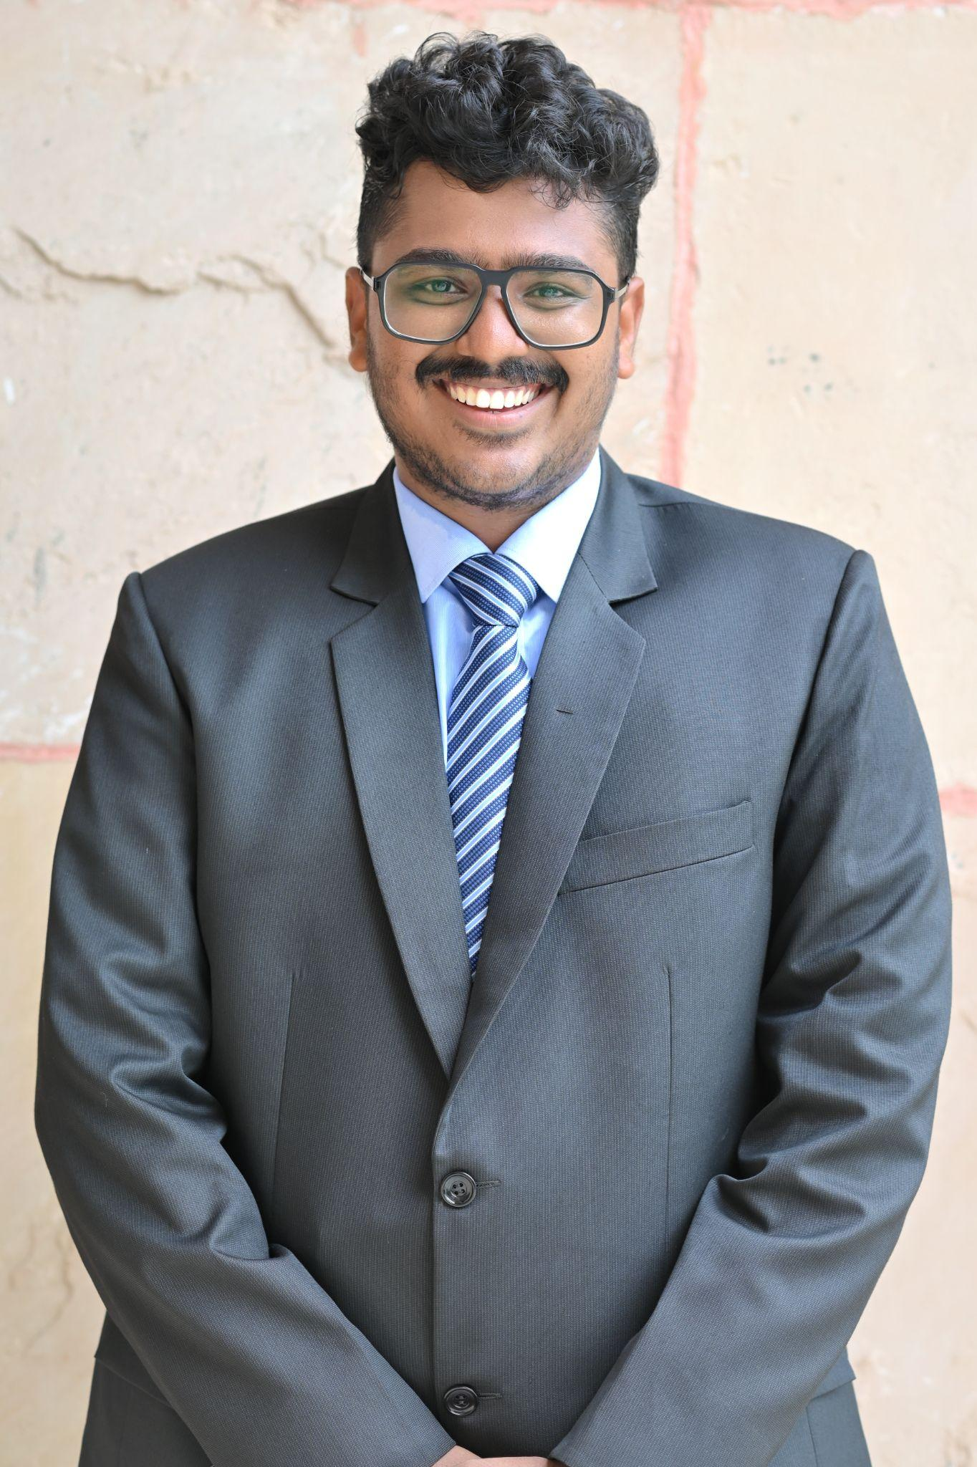
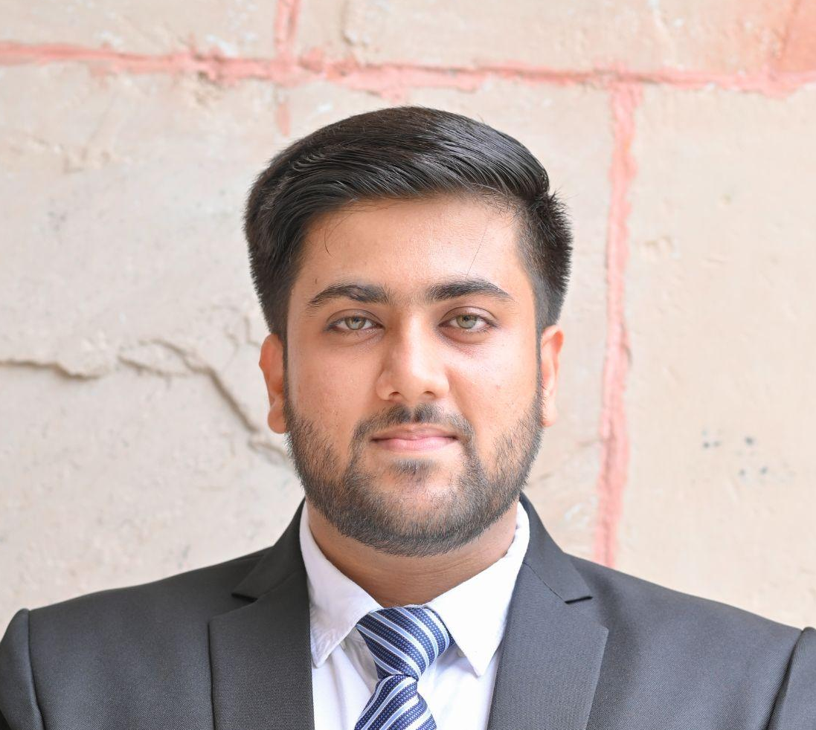
‘The Treasure Hunt’ - Presented by
Baibhaba Nath - 234024004
Optimist (Conscientiousness)
Rahul Kumar - 234024016
Adventurous (Extraversion)
T.V Anudeep Naidu - 234024024
Intellectual (Openness to Experience)
Saurabh Yadav - 234024020
Practical Thinker (Agreeableness)

Slide 3
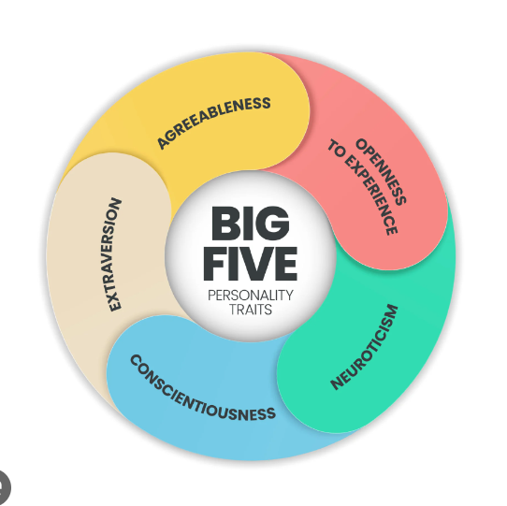
Big 5 Theory of Personality

Slide 4
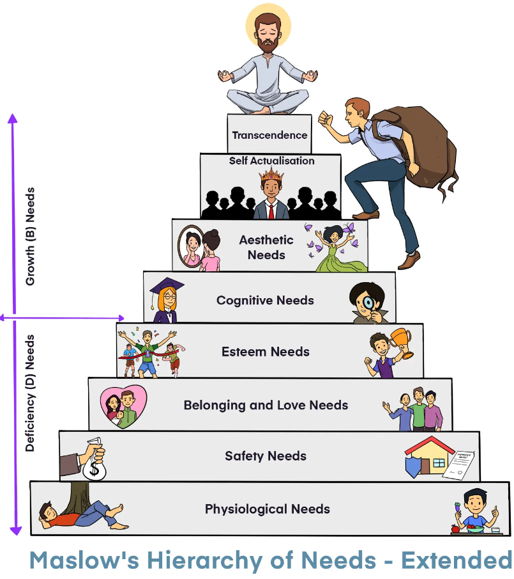
Motivation Theory - Maslow’s Hierarchy of Needs

Slide 5
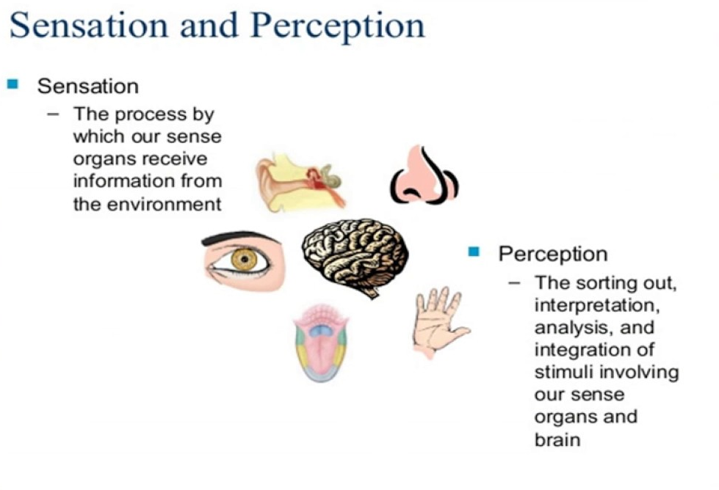
Perception Theory

Slide 6
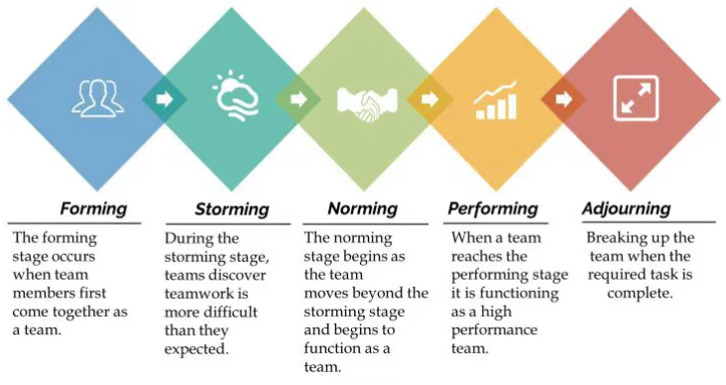
Group Dynamics

Slide 7

The Treasure Hunt
Scene - 1: Coffee Shop
Group Formation, Individual Level Analysis, Perceptual Process
Scene - 2: Rahul’s Living Room
Values and Attitudes
Scene - 3: Treasure Hunt - Day 1
Group Level Analysis
Scene - 4: Deep in the Forest
Group Decision Making and Analysis
Scene - 5: Late Night Camping
Motivation
Scene - 6: Treasure Hunt - Day 2
Achieving the Goal Together
Scene - 7: Returning Home
Learning from the process

Slide 8
Summary
This story was a small representation of how we can use the OB Concepts not only in the organization but also we can apply them in our day to day life to achieve our ultimate goal!

Slide 9
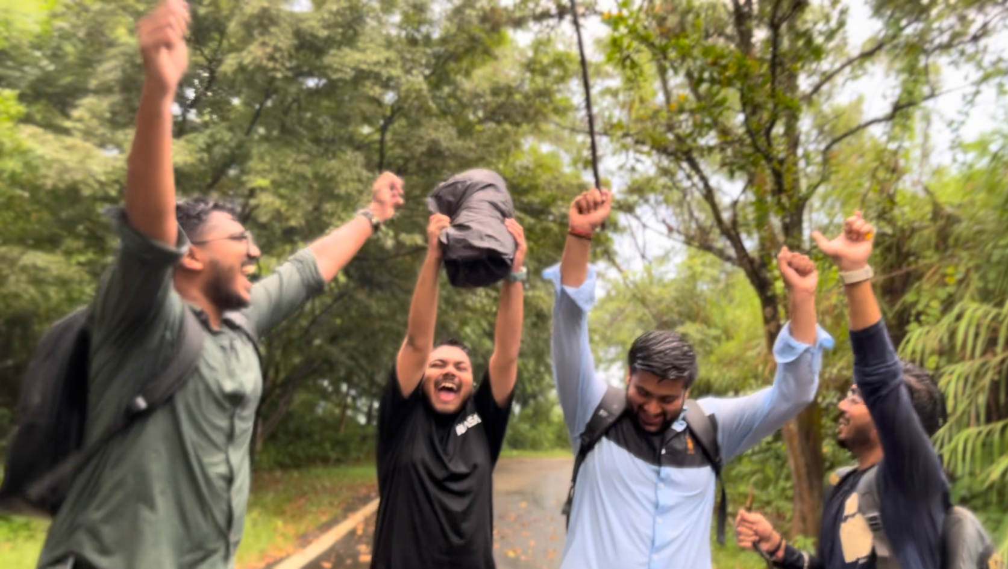
THANK YOU

